Slide 1
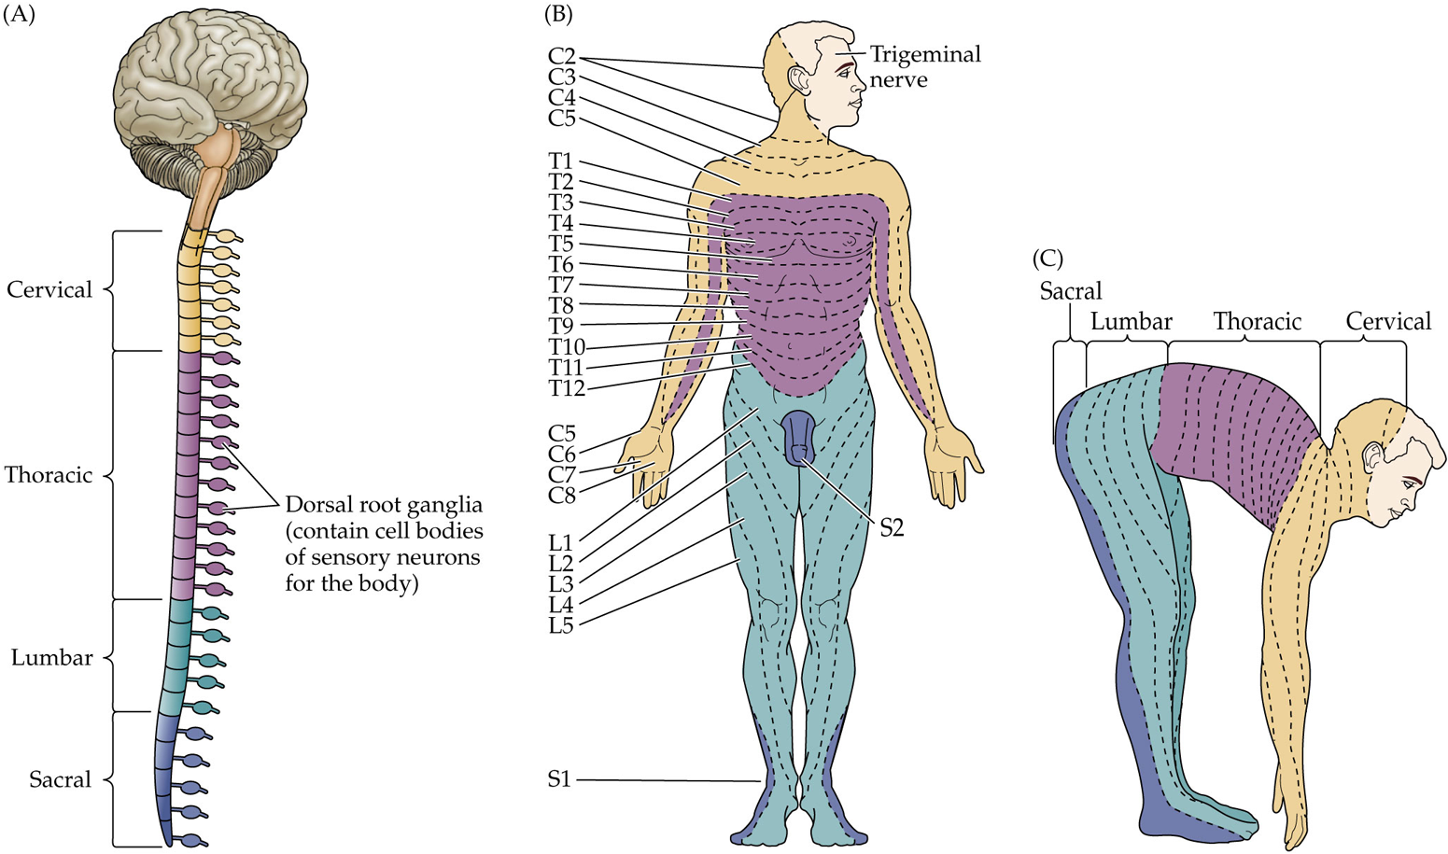
The Spinal Nerves and Dermatomes
Each division of the spinal cord is associated with a pair of spinal nerves that innervate a specific part of the body.
  Cervical: back of head, neck, tops of arms, and hands
  Thoracic: torso and underside of arms
  Lumbar: hips and front of legs
  Sacral: back of legs and genitals

Slide 2
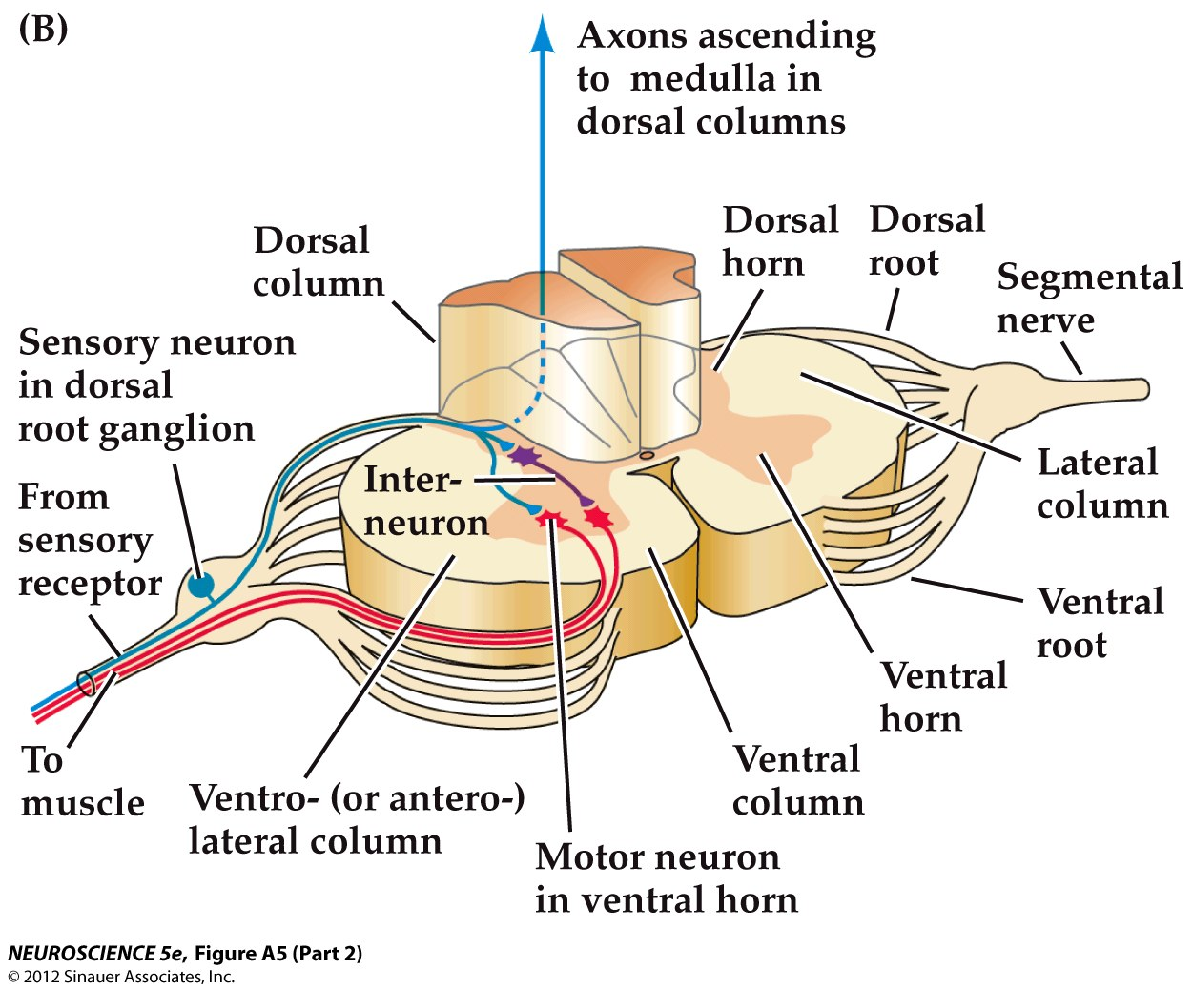
Internal structure of the spinal cord
At each spinal level, there is a regular pattern of:
  sensory input (afferents)
  synaptic connections
  motor output (efferents)

Slide 3
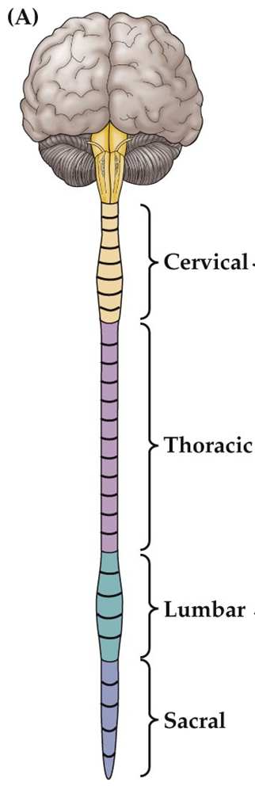
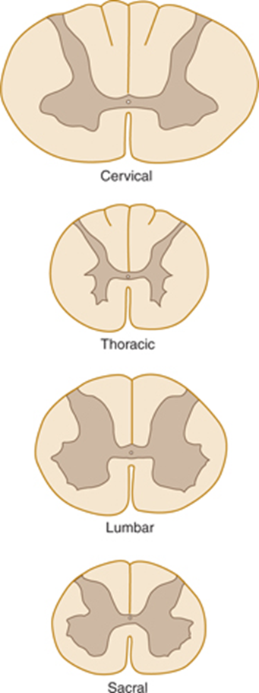
Internal structure of the spinal cord
The four main divisions of the spinal cord have a characteristic arrangement of gray and white matter.
  Gray matter: primarily cell bodies
  White matter: primarily myelinated axons

Slide 4
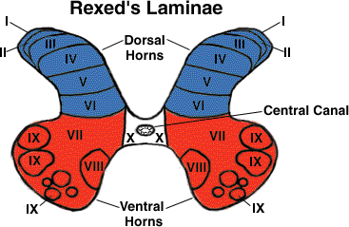
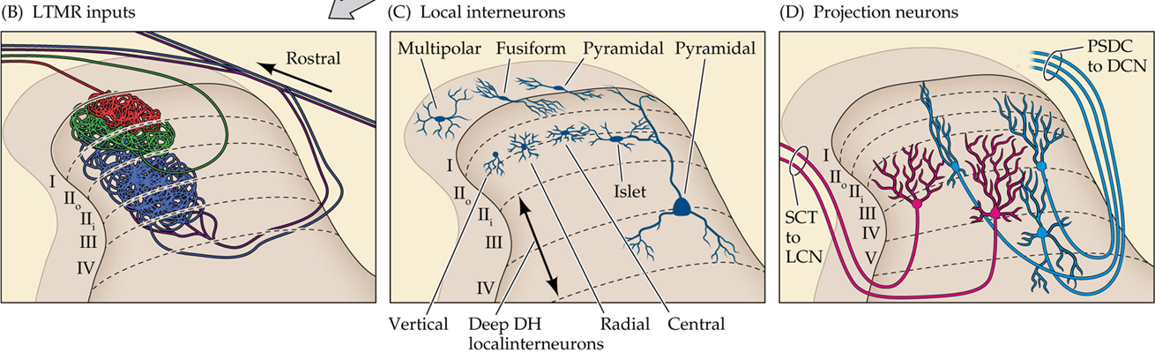
Gray matter:
The spinal horns
Layering helps maintain a topographic (aka somatotopic) organization
The dorsal horns are important for processing somatosensory information and transmitting it to the brain.
  Layer 2 mostly consists of interneurons
  Layers 3-5 mostly contains projection neurons
The ventral horns contain cell bodies of motor neurons that innervate skeletal muscles.

Slide 5
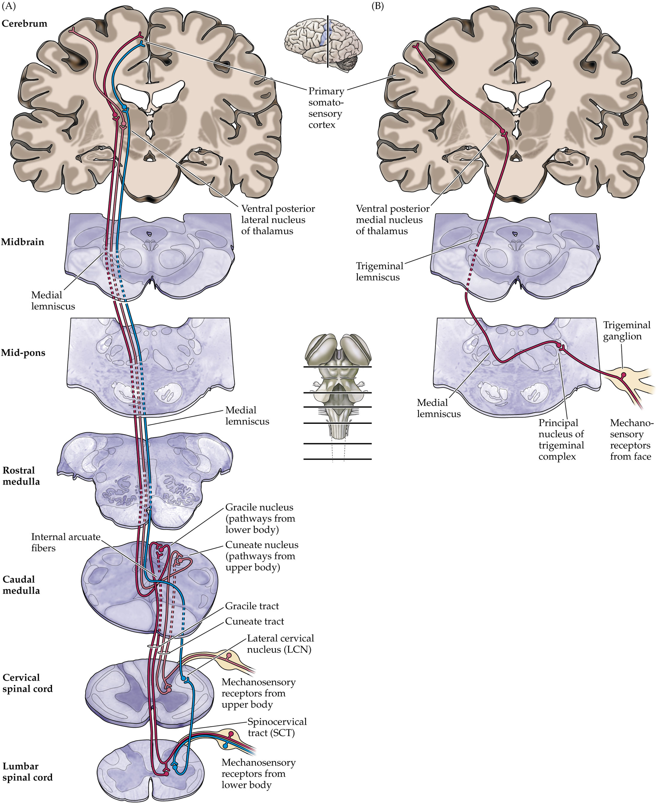
somatosensory white matter tracts through the spinal cord
Somatic sensation from the body
  Mechanosensory systems use the dorsal column/medial lemniscal (DC/ML) system
  Pain and temperature use the anterolateral system
Somatic sensation from the face
  Mechanosensation and pain/temperature both use the trigeminal system

Slide 6
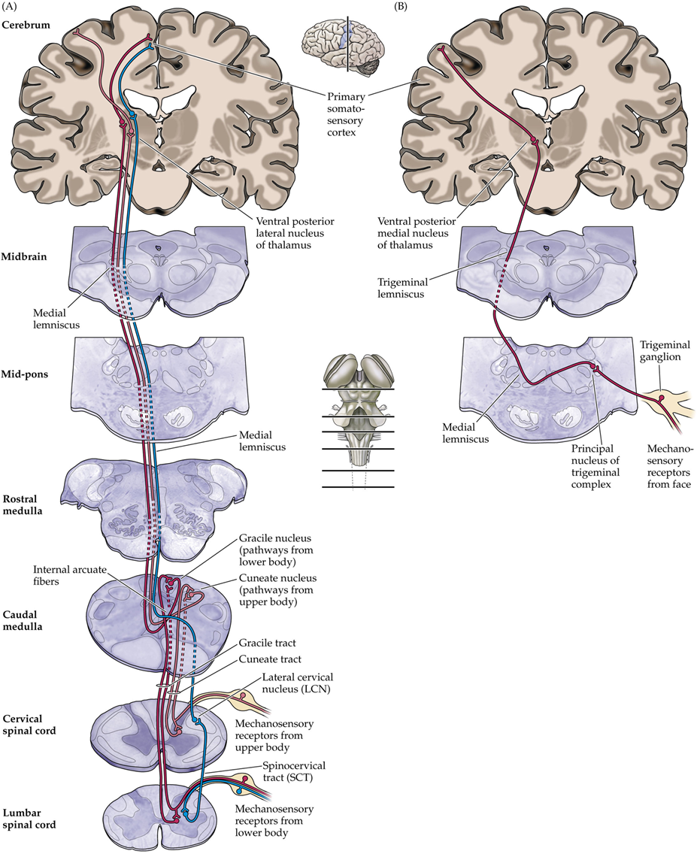
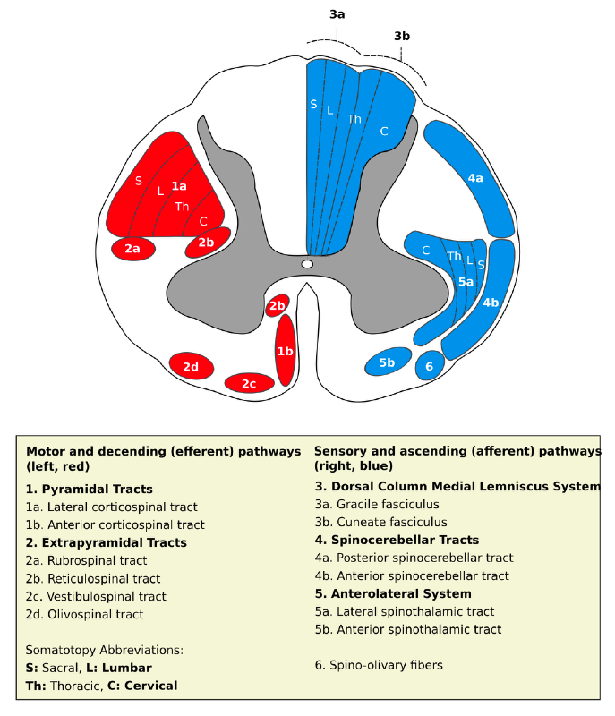

DC/ML PSDC Pathways
postsynaptic dorsal column (PSDC) neurons (first order neurons)
Lumbar and sacral fibers (lower body) use the gracile tract (GT).
Cervical fibers (upper body) use the cuneate tract (CT).
Thoracic fibers use a bit of both
  T6 and above (upper body) = CT
  T7 and below (lower body) = GT
Both tracts terminate in the dorsal column nuclei of the medulla.
Second-order neurons in the DCN project to the ventral posterior lateral (VPL) nucleus of the thalamus.
  The projections are referred to as the internal arcuate fibers.
  They cross the midline and form the medial lemniscus tract

Slide 7
DC/ML SCT Pathway
spinocervical tract (SCT) neurons (also first-order neurons) use a separate pathway.
  Primarily input from hairy skin
  SCT neuron projections travel through the dorsolateral white matter and terminate in the lateral cervical nucleus (LCN, in the spinal cord)
  LCN second-order neurons cross the midline at the dorsal commissure in the medulla and then join the PSDC neuron pathways in the medial lemniscus.
Third-order neurons in the VPL project to primary somatosensory cortex and secondary somatosensory cortex.

Slide 8
Trigeminal pathway
Trigeminal ganglion cells (first-order neurons) send somatosensory information from the face to the principal nucleus of the trigeminal complex in the brainstem.
Second-order neurons cross the midline and form the trigeminal lemniscus, which terminates in the ventral posterior medial (VPM) nucleus of the Thalamus.
VPM neurons (third-order neurons) project to primary and secondary somatosensory cortices.

Slide 9
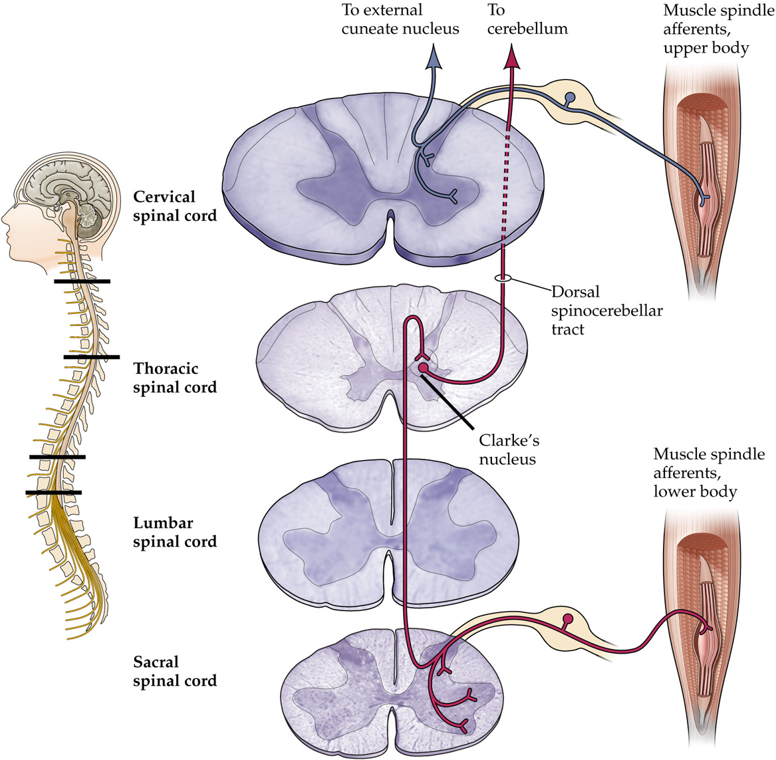
Proprioceptive Pathways
Proprioceptive afferents from the body enter through dorsal roots and form two pathways (Dorsal Column and Spinocerebellar)
Dorsal Column
  Afferents from upper body travel up the dorsal column and synapse with neurons in the external cuneate nucleus (ECN) of the medulla.
  Second-order neurons in the ECN project to the cerebellum and the VPL

Slide 10
Proprioceptive Pathways
Spinocerebellar
  Afferents from lower body travel up the dorsal column and synapse with neurons in Clark’s nucleus in the spinal cord.
  Second-order neurons in Clark’s nucleus project through the dorsal spinocerebellar tract to reach the cerebellum.
    Some collaterals synapse with neurons just outside the nucleus gracilis.
      These neurons act as third-order neurons and their projections go to the VPL.

Slide 11
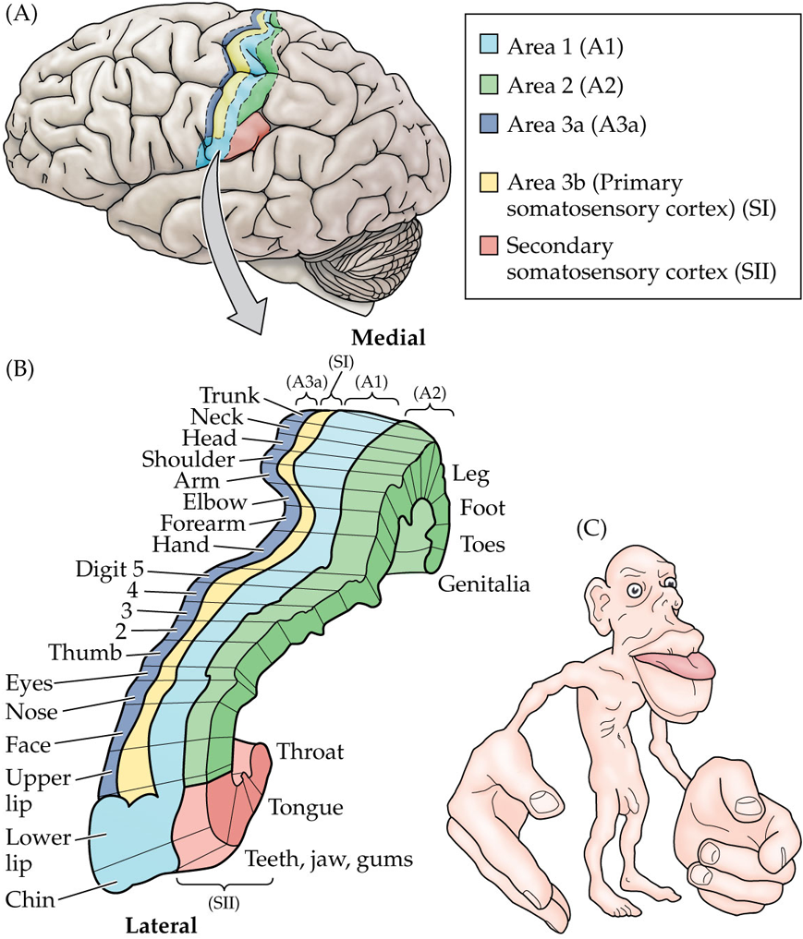
Primary somatosensory cortex
Broadman’s area 1, 2, 3a &3b
  And secondary somatosensory cortex
  Only 3b is considered primary somatosensory cortex
Each area has a separate complete representation of the body
  Medial to lateral arrangement of lower body parts to upper body parts and face.
  3b & 1 respond to cutaneous stimuli
  3a responds to proprioceptive stimuli
  2 processes both
Larger cortical representation = greater processing power.

Slide 12
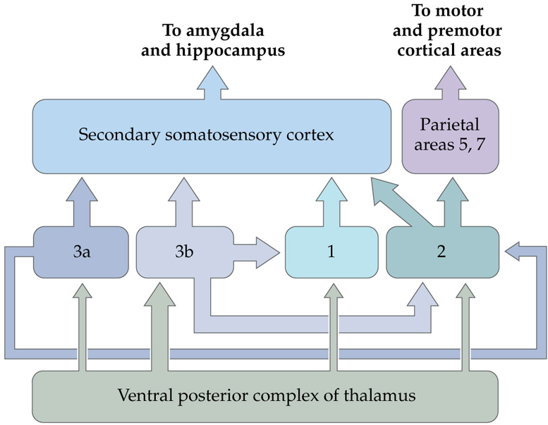
Somatosensory Corticocortical connections

Slide 13
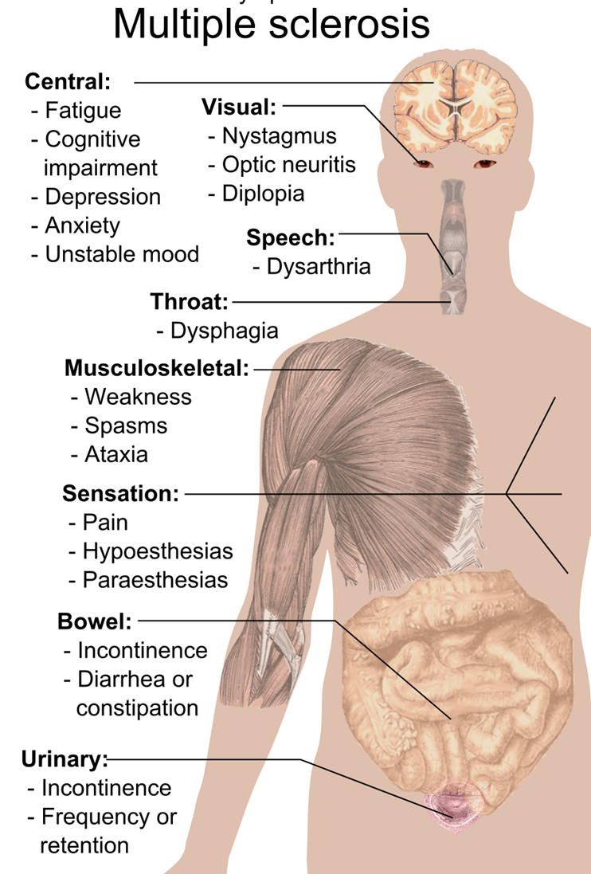
Dysfunction of the somatosensory system:
Multiple Sclerosis
Multiple Sclerosis often affects sensory and motor neurons, likely contributing to sensory and motor symptoms.

Slide 14
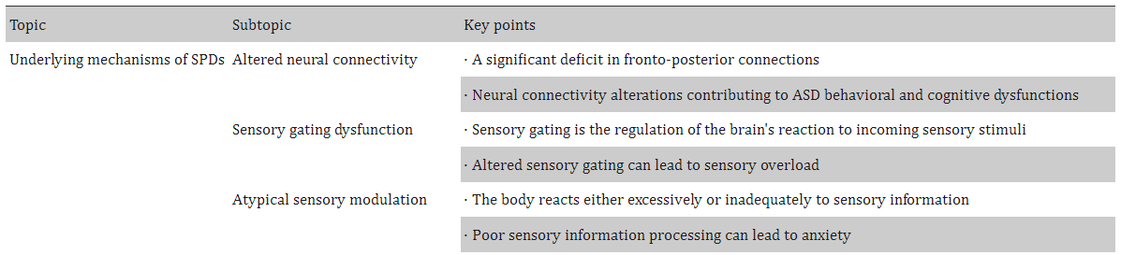
Dysfunction of the somatosensory system:
Autism Spectrum Disorder (ASD)
Individuals with ASD often exhibit abnormal reactions to sensory stimuli, especially touch and pain.
  Severity of somatosensory processing alterations positively correlates with ASD symptom severity.
  Some alterations may be due to decreased synaptic pruning in thalamus or sensory cortices
  There are also alterations in peripheral sensory neurons themselves
Patil & Kaple, 2023

Slide 15
Dysfunction of the somatosensory system:
Sensory Processing Disorder
A neurological condition where the brain has difficulty processing and interpreting sensory information
There are several different types (e.g. over-responsivity, under-responsivity, craving or seeking, etc…), not all include somatosensory information.
Symptoms vary based on type and senses affected, but most common are:
  Clumsiness/difficulty with fine motor skills
  Discomfort from certain fabrics
  Gagging from certain food textures
  Need to constantly touch things
Often comorbid with many neurodevelopmental conditions
https://my.clevelandclinic.org/health/diseases/sensory-processing-disorder-spd

Slide 16
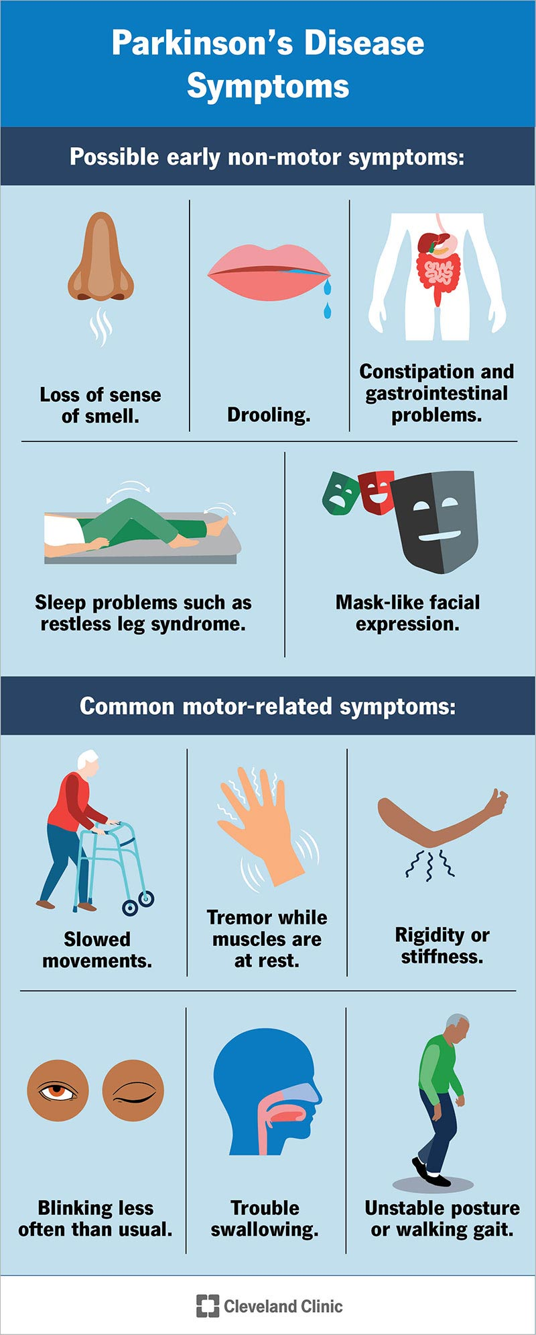
Dysfunction of the somatosensory system:
Parkinson’s Disease
Parkinson’s disease: a progressive neurodegenerative disorder that affects motor and sensory systems.
  Progressive loss of neurons in the basal ganglia and a deficiency of dopamine.
    motor symptoms may include tremor, muscular rigidity, and slow, imprecise movement.
  Loss of skin sensory afferents and Meissner corpuscles.
    Sensory symptoms may include reduced sense of touch, increased pain, and loss of smell.

